Slide 2
Përmbajtja
Hyrje ne Sistemet Operative
Struktura e Sistemeve Operative
Menaxhimi i Proceseve
Threads & Concurrency
Skedulimi i CPU, Sinkronizimi, Deadlocks
Menaxhimi i Memories, Memoria Kryesore dhe Virtuale
Struktura e Sistemeve për Ruajtjen e Shënimeve
I/O Sistemet, dhe Konfigurimi i Pajisjeve
Ndërfaqja dhe Implementimi i File Sistemeve
Mbrojtja dhe Siguria
Virtualizimi, Cloud Computing
Rrjetet dhe Sistemet e Shpërndara

Slide 3
Topic 4 - Recap
Overview
Multicore Programming
Multithreading Models
Operating System Examples
CPU Schedule

Slide 4
Outline
Background
The Critical-Section Problem
Hardware Support for Synchronization
Mutex Locks
Semaphores
Monitors

Slide 5
Objectives
Describe the critical-section problem and illustrate a race condition
Illustrate hardware solutions to the critical-section problem using memory barriers, compare-and-swap operations, and atomic variables
Demonstrate how mutex locks, semaphores, monitors, and condition variables can be used to solve the critical section problem
Evaluate tools that solve the critical-section problem in low-, Moderate-, and high-contention scenarios

Slide 6
Background
Processes can execute concurrently
May be interrupted at any time, partially completing execution
Concurrent access to shared data may result in data inconsistency
Maintaining data consistency requires mechanisms to ensure the orderly execution of cooperating processes
We illustrated in chapter 4 the problem when we considered the Bounded Buffer problem with use of a counter that is updated concurrently by the producer and consumer,. Which lead to race condition.

Slide 7
Sinkronizimi i Proceseve
Sinronizimi i Proceseve
Koordinimi ne mes tyre
Evitimi i konflikteve
Kjo kerkon nje komunikim ne mes te proceseve dhe ky komunikim duhet te perkrahet nga sistemi kompjuteristik.
Sinkronizmi perdoret per kontrolluar qasjen tek:
Sistemet e vogla multi-procesuese
Kompjuteret me multi-procesor dhe sistemet me multi-threde
Sistemet distributive qe perfshine mijera njesi
Si tek sistemet bankare dhe databazave,
Si tek serverat ne Web etj

Slide 8
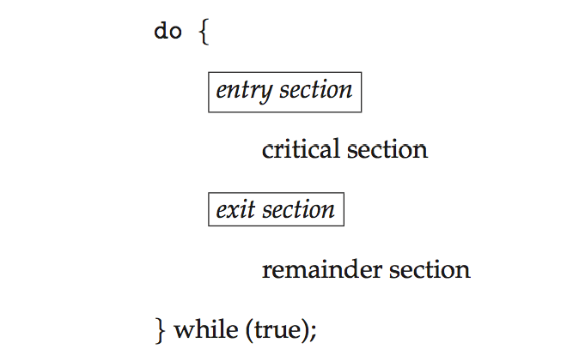
Seksioni Kritik
Çdo proces ka një segment te kodit qe quhet seksioni kritik. Ne këtë seksioni procesi munde te jete duke ndryshuar ndonjë variabël, duke rishkruar një tabelë, duke shkruar një file etj.
Entry Section
Exit Section
Reminder Section

Slide 9
Problemi i Seksioni Kritik
Zgjidhja e problemit te seksionit kritik duhet ti përmbush këto tri kërkesa:
Përjashtimin Reciprok – Nëse një procese është duke e ekzekutuar seksionin kritik atëherë asnjë proces tjetër nuk lejohet te ekzekutoj seksionin kritik
Vazhdimësinë/Progresin – Nëse asnjë prej proceseve nuk gjendet ne fazën kritike dhe disa prej proceseve janë duke tentuar te hyjnë ne fazën kritike atëherë vetëm ato procese te cilat nuk gjenden ne seksionin Reminder munde te pjesëmarrës ne vendimmarrjen se cili proces duhet te hyj ne fazën kritike. Kjo vendimmarrje nuk duhet te jete e stërzgjatur ose e pafundme.
Pritjet e Kufizuara (Bounded Waiting) – Ekziston një limit një kufizim për numrin se sa here një proces lejohet qe te hyje ne fazën kritike pasi qe ai proces te këtë bere kërkesën edhe pasi qe i është aprovuar kërkesa.

Slide 10
Interrupt-based Solution
Entry section: disable interrupts
Exit section: enable interrupts
Will this solve the problem?
What if the critical section is code that runs for an hour?
Can some processes starve – never enter their critical section.
What if there are two CPUs?

Slide 11
Sinkronizimi Harduerik
Te gjitha sinkronizimet janë te bazuara ne LOCK’s
Sistemet me një Procesor Ndërprerja e sinjaleve kontrolluese (Interrrupts)
Shume e thjeshte, por mund te shkaktoje probleme
Nëse nderprehen sinjalet kontrolluese gjate qasjes ne zonën kritike, koha e sistemit nuk operon
Gjate kësaj kohe po ashtu nuk është e mundur te ndjekja e gjurmëve te një procesi për shkak se koha e sinjaleve kontrolluese nuk funksionon
Nëse sistemi ndërpritet te punon si duhet atëherë as proceset qe përfundojnë ekzekutimet nuk do t’ia kthejnë kontrollin sistemit

Slide 12
Sinkronizimi Harduerik
Sistemet moderne me shume procesor ofrojnë instruksione harduerike shumë te vogla – Atomic
Atomic – non-interruptible
Test and Set (Kontrollo dhe Vendos)
Compare and Swap (Krahaso dhe Shkëmbe)
Është një instruksion i pa zbërthyer qe përdoret ne multi-threding për te mundësuar sinkronizimin dhe përjashtimin reciprok
Realizon përjashtimin reciprok për çfarëdo strukture te te dhënave duke e krijuar një liste ne te cilën çdo proces paraqet preference për operacionet qe duan t’i ekzekutojnë
Krahason përmbajtjen e lokacionit te memories me një vlere specifike dhe vetëm nëse ato shifra qe krahasohen përputhen do te lejohet modifikimi i përmbajtjes se lokacionit te memories ne një vlere tjetër te re. Këtu pra është ajo se ku fillon te aplikohet shkëmbimi.

Slide 13
Mutex
Ne sistemet konkuruese, perjashtimi reciprok, apo siq njihet edhe si ‘Mutex’, qe eshte nje lloj kodi apo program (program object) qe u mundeson shume thredeve qasje ne burime te perbashketa, por jo kohe te njejte.
Kur nje program fillon se ekzekutuari, krijohet nje kod (mutex) qe i lejon qasje ketij programi ne burime te perbashketa dhe i cili kod ka nje emer unik.
Pas ketij hapi, cilido thred qe kerkon qasje ne keto burime duhet te bllokoje kodin ‘mutex’ prej thredeve tjera deri sa vazhdon te kete qasje ne burime te perbashketa. Ky kod (mutex) lirohet ose zhbllokohet sapo te perfundoje ekzekutimi.

Slide 14
Mutex Locks
Previous solutions are complicated and generally inaccessible to application programmers
OS designers build software tools to solve critical section problem
Simplest is mutex lock
Boolean variable indicating if lock is available or not
Two operations:
acquire() a lock
release() a lock
The acquire() and release()are executed atomically
Usually implemented via hardware atomic instructions such as compare-and-swap.
But this solution requires busy waiting
This lock therefore called a spinlock

Slide 15
Semaforet
Semafori ne sistemet konkuruese dhe qe nganjehere njihet edhe si qeles/Token semafori eshte nje concept programimi qe perdoret shpesh per te zgjidhur problem te ndryshme me multi-threding.
Tri funksionet kryesore te lidhura me semaforet jane:
Vendos (Set)
Kontrollo (check) dhe
Prit deri sa vlera paraprake eshte realizuar dhe te vendoset prap.

Slide 16
Semaforet
Prit(S) (Wait (S))
Vlera e S qe paraqet numrin e Tokeneve te semaforit zvoglohet per 1 sa here qe nje process/thred e merr nje Token
Kontrollo vleren e S
Nese S eshte zero, pera nuk ke me Tokena, ateher duhet shkuar per te vjetur apo pritur deri san je proces nuk e ka kthyer nje Token dhe nuk e ka lajmeruar kete kthim
Signal (S)
Vera e S rritet per 1 sa here qe nje process/thred a kthen ndonje Token
Ky kthim e lajmeron procesin/thredin duke pritur dhe mund te zgjohet nese ka qene duke fjetuer

Slide 17
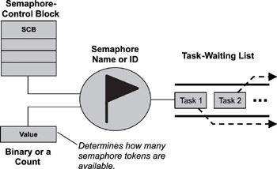
Semaforet

Slide 18
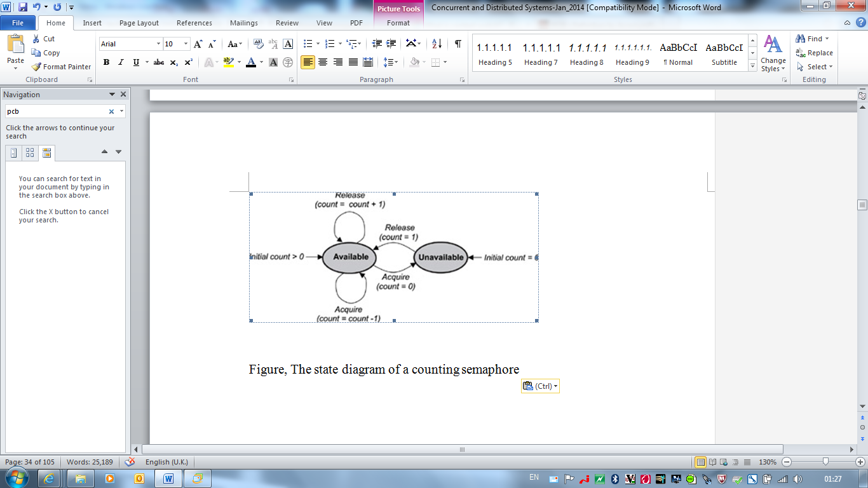
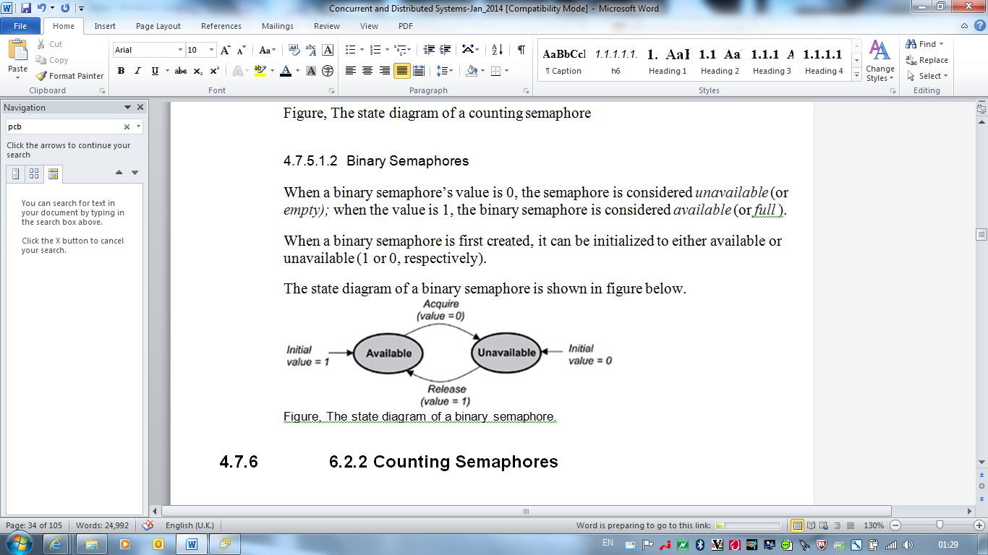
Semaforet
Llojet e Semaforeve
Semaforet numerues
Jane lloj i pergjithshem i semaforeve
Semaforet binar
Nje rast specific i semaforeve

Slide 19
Mutex vs. Semaforet
Mutex (shkurt për Mutual Exclusion) është një mekanizëm për bllokim qe përdoret për sinkronizim te qasjes ne burimet e përbashkëta. Vetëm një proces apo thred mund te marr qelësin e bllokimit (Mutex). Kjo do te thot se ne rastin e Mutex, Mutex është ne pronësi te dikujt dhe vetëm pronari mund te liroje këtë qelës.
Semafori kufizon numrin e shfrytëzuesve qe mund te kenë qasje ne burimet e përbashkëta ne te njëjtën kohe. Thredet mund te kërkojnë te kenë qasje tek burimet (duke e zvogëluar numrin e Tokenëve) dhe mund te sinjalizojnë kur te mbarojnë pune (duke e rritur numrin e Tokenëve).
Mutex konsiderohet te jete shume i ngjashëm me semaforin binar

Slide 20
Monitoret
Është një koncept me rendësi për sinkronizim ne sistemet operative.
Ne programim konkurues, monitori është një koncept qe u mundëson thredeve te kenë qasje ne burime përmes përjashtimit reciprok dhe te kenë mundësinë për te pritur/bllokuar deri sa një kusht nuk plotësohet.
Monitorët po ashtu kane një mekanizëm për t’i sinjalizuar thredet tjera kur një kusht është plotësuar.
Pseudocode syntax of a monitor:
monitor monitor-name
{
// shared variable declarations
function P1 (…) { …. }
function P2 (…) { …. }
function Pn (…) {……}
initialization code (…) { … }
}

Slide 21
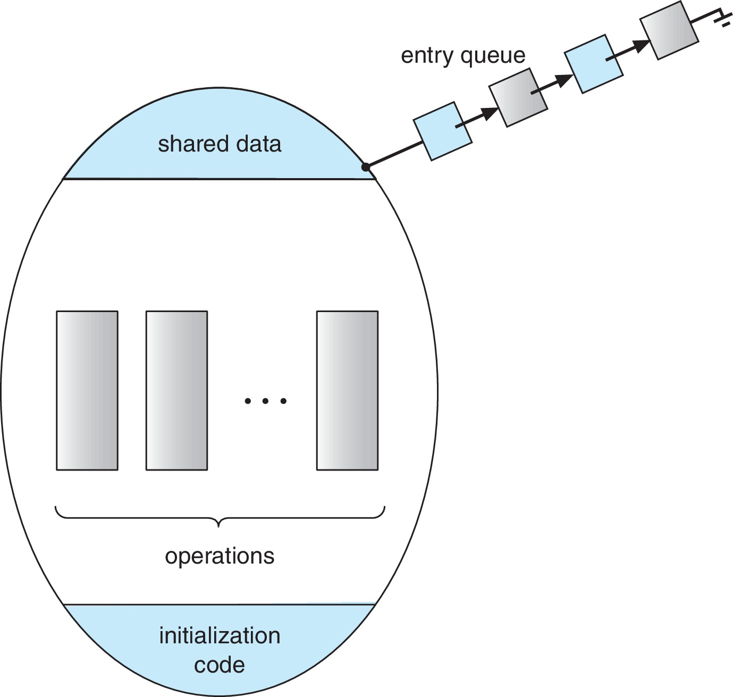
Schematic view of a Monitor

Slide 22
Condition Variables
condition x, y;
Two operations are allowed on a condition variable:
x.wait() – a process that invokes the operation is suspended until x.signal()
x.signal() – resumes one of processes (if any) that invoked x.wait()
If no x.wait() on the variable, then it has no effect on the variable

Slide 23
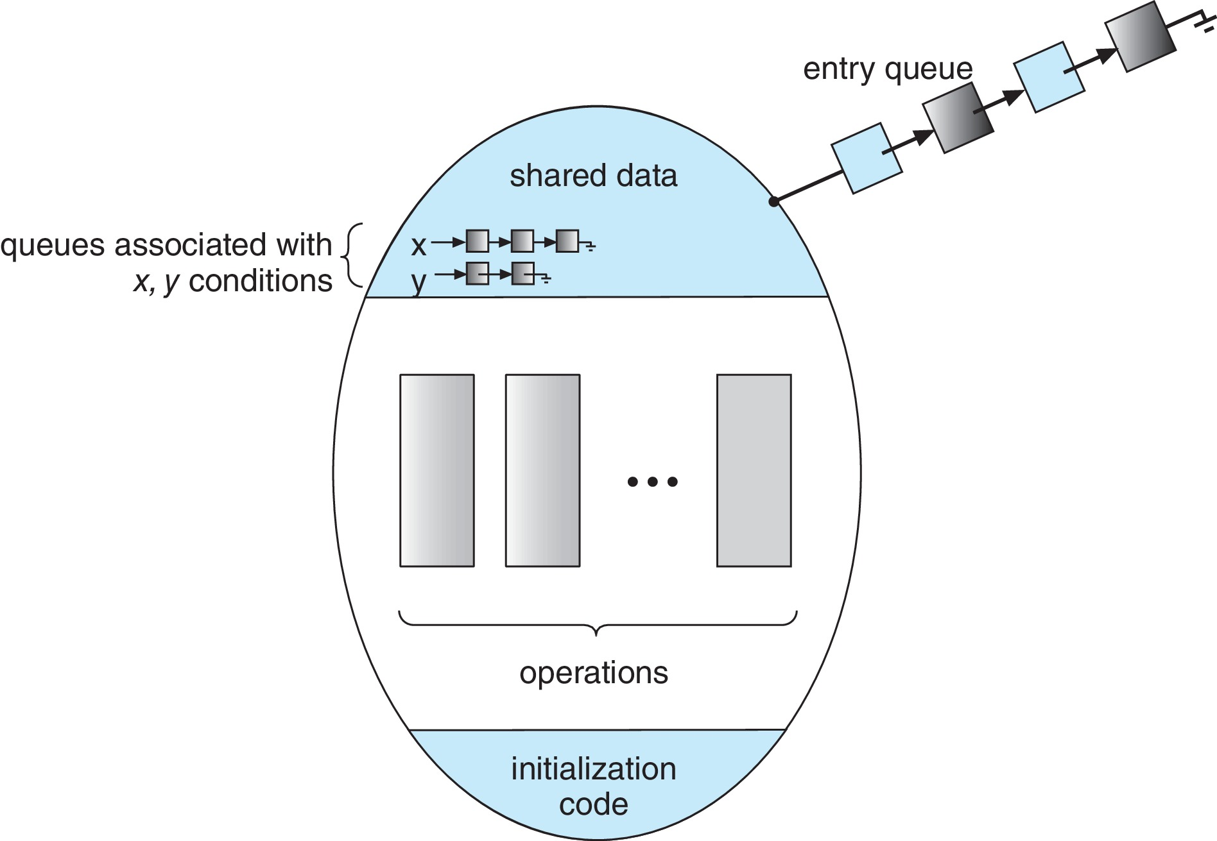
Monitor with Condition Variables

Slide 24
Monitoret vs. Semaforet
Operacionet wait dhe signal
Funksioni wait
Semaforet – Nese numri > 0 nuk bllokohet procesi
Monitoret – Bllokohet
Funksioni signal
Semaforet – ose zhbllokohet ose rritet numri i tokeneve
Monitoret – Nuk ka efekt ne variablen kushtezuese

Slide 25
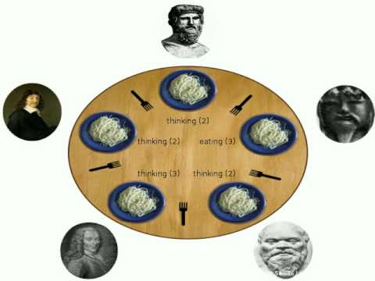
Shembuj te Sinkronizimit te Proceseve
Problemi i darkës se filozofëve
Eat
Think

Slide 26
End of Chapter 6

Slide 27
Outline
System Model
Deadlock Characterization
Methods for Handling Deadlocks
Deadlock Prevention
Deadlock Avoidance
Deadlock Detection
Recovery from Deadlock

Slide 28
Chapter Objectives
Illustrate how deadlock can occur when mutex locks are used
Define the four necessary conditions that characterize deadlock
Identify a deadlock situation in a resource allocation graph
Evaluate the four different approaches for preventing deadlocks
Apply the banker’s algorithm for deadlock avoidance
Apply the deadlock detection algorithm
Evaluate approaches for recovering from deadlock

Slide 29
System Model
System consists of resources
Resource types R₁, R₂, . . ., R_{m}
CPU cycles, memory space, I/O devices
Each resource type R_{i} has W_{i} instances.
Each process utilizes a resource as follows:
request
use
release

Slide 30
Deadlock Characterization
Deadlock can arise if four conditions hold simultaneously.
Mutual exclusion: only one process at a time can use a resource
Hold and wait: a process holding at least one resource is waiting to acquire additional resources held by other processes
No preemption: a resource can be released only voluntarily by the process holding it, after that process has completed its task
Circular wait: there exists a set {P₀, P₁, …, P_{n}} of waiting processes such that P₀ is waiting for a resource that is held by P₁, P₁ is waiting for a resource that is held by P₂, …, P_{n–1} is waiting for a resource that is held by P_{n}, and P_{n} is waiting for a resource that is held by P₀.

Slide 31
Resource-Allocation Graph
A set of vertices V and a set of edges E.
V is partitioned into two types:
P = {P₁, P₂, …, P_{n}}, the set consisting of all the processes in the system
R = {R₁, R₂, …, R_{m}}, the set consisting of all resource types in the system
request edge – directed edge P_{i} → R_{j}
assignment edge – directed edge R_{j} → P_{i}

Slide 32
Resource-Allocation Graph (Cont.)
Thread
Resource Type with 4 instances
P_{i} requests instance of R_{j}
P_{i} is holding an instance of R_{j}
P_{i}
R_{j}
P_{i}
R_{j}

Slide 33
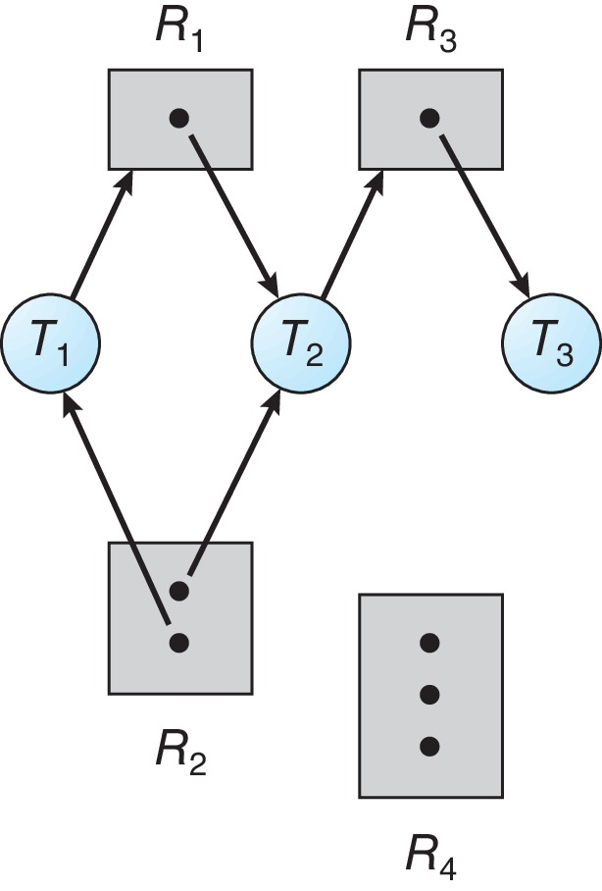
Resource Allocation Graph Example
One instance of R1
Two instances of R2
One instance of R3
Three instance of R4
T1 holds one instance of R2 and is waiting for an instance of R1
T2 holds one instance of R1, one instance of R2, and is waiting for an instance of R3
T3 is holds one instance of R3

Slide 34
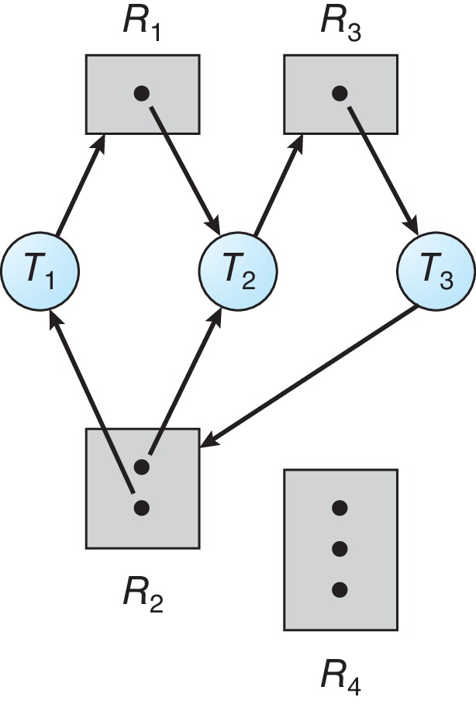
Resource Allocation Graph with a Deadlock

Slide 35
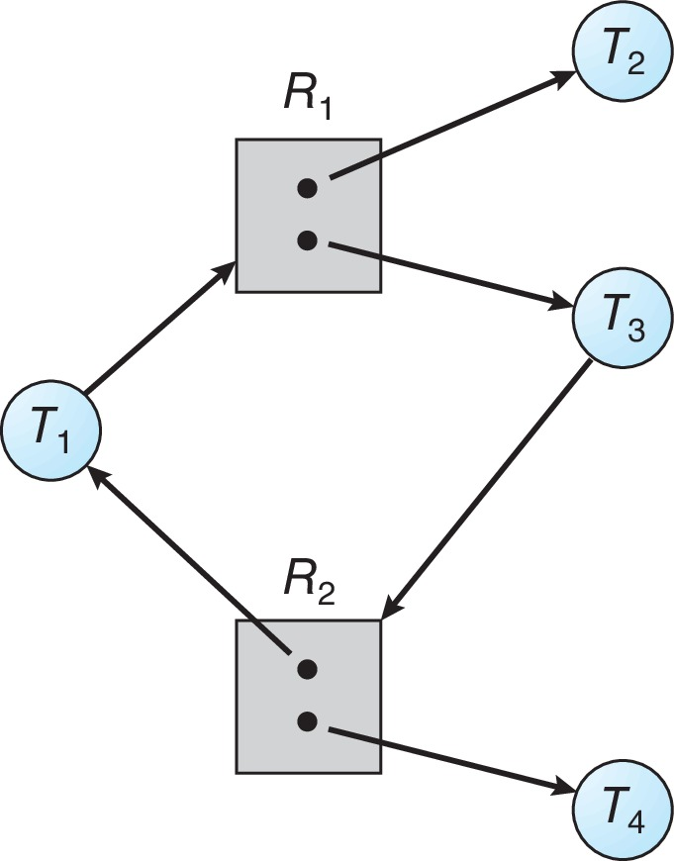
Graph with a Cycle But no Deadlock

Slide 36
Basic Facts
If graph contains no cycles ⇒ no deadlock
If graph contains a cycle ⇒
If only one instance per resource type, then deadlock
If several instances per resource type, possibility of deadlock

Slide 37
Methods for Handling Deadlocks
Ensure that the system will never enter a deadlock state:
Deadlock prevention
Deadlock avoidance
Allow the system to enter a deadlock state and then recover
Ignore the problem and pretend that deadlocks never occur in the system.

Slide 38
Deadlock Prevention
Invalidate one of the four necessary conditions for deadlock:
Mutual Exclusion – not required for sharable resources (e.g., read-only files); must hold for non-sharable resources
Hold and Wait – must guarantee that whenever a process requests a resource, it does not hold any other resources
Require process to request and be allocated all its resources before it begins execution, or allow process to request resources only when the process has none allocated to it.
Low resource utilization; starvation possible

Slide 39
Deadlock Prevention (Cont.)
No Preemption:
If a process that is holding some resources requests another resource that cannot be immediately allocated to it, then all resources currently being held are released
Preempted resources are added to the list of resources for which the process is waiting
Process will be restarted only when it can regain its old resources, as well as the new ones that it is requesting
Circular Wait:
Impose a total ordering of all resource types, and require that each process requests resources in an increasing order of enumeration

Slide 40
Deadlock Avoidance
Requires that the system has some additional a priori information available
Simplest and most useful model requires that each process declare the maximum number of resources of each type that it may need
The deadlock-avoidance algorithm dynamically examines the resource-allocation state to ensure that there can never be a circular-wait condition
Resource-allocation state is defined by the number of available and allocated resources, and the maximum demands of the processes

Slide 41
Safe State
When a process requests an available resource, system must decide if immediate allocation leaves the system in a safe state
System is in safe state if there exists a sequence <P₁, P₂, …, P_{n}> of ALL the processes in the systems such that for each P_{i}, the resources that P_{i} can still request can be satisfied by currently available resources + resources held by all the P_{j}, with j < I
That is:
If P_{i} resource needs are not immediately available, then P_{i} can wait until all P_{j} have finished
When P_{j} is finished, P_{i} can obtain needed resources, execute, return allocated resources, and terminate
When P_{i} terminates, P_{i +1} can obtain its needed resources, and so on

Slide 42
Basic Facts
If a system is in safe state ⇒ no deadlocks
If a system is in unsafe state ⇒ possibility of deadlock
Avoidance ⇒ ensure that a system will never enter an unsafe state.

Slide 43
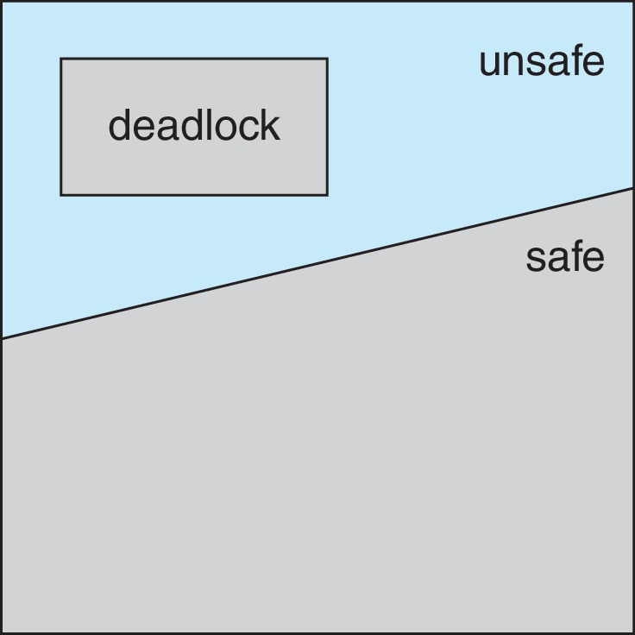
Safe, Unsafe, Deadlock State

Slide 44
Avoidance Algorithms
Single instance of a resource type
Use a modified resource-allocation graph
Multiple instances of a resource type
Use the Banker’s Algorithm

Slide 45
Modified Resource-Allocation Graph Scheme
Claim edge P_{i} --> R_{j} indicates that process P_{i} may request resource R_{j}
Request edge P_{i} → R_{j} indicates that process P_{i} requests resource R_{j}
Claim edge converts to request edge when a process requests a resource
Assignment edge R_{j} → P_{i} indicates that resource R_{j} was allocated to process P_{i}
Request edge converts to an assignment edge when the resource is allocated to the process
When a resource is released by a process, assignment edge reconverts to a claim edge
Resources must be claimed a priori in the system

Slide 46
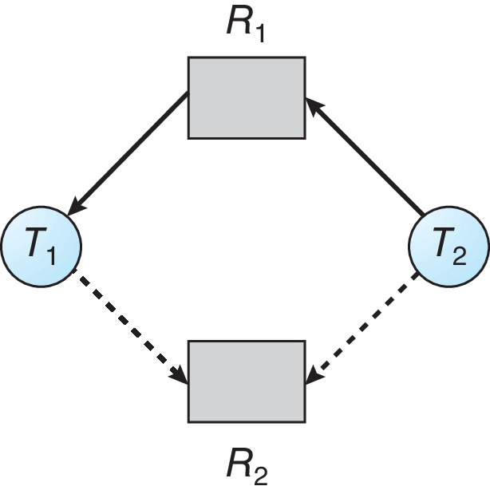
Resource-Allocation Graph

Slide 47
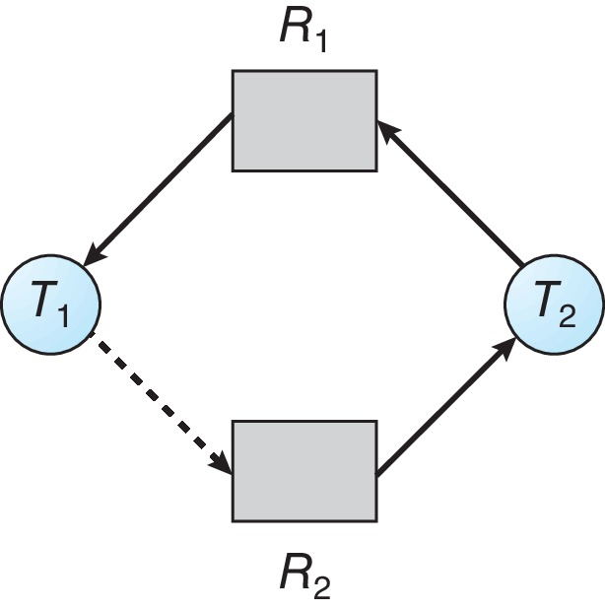
Unsafe State In Resource-Allocation Graph

Slide 48
Resource-Allocation Graph Algorithm
Suppose that process P_{i} requests a resource R_{j}
The request can be granted only if converting the request edge to an assignment edge does not result in the formation of a cycle in the resource allocation graph

Slide 49
Deadlock Detection
Allow system to enter deadlock state
Detection algorithm
Recovery scheme

Slide 50
Single Instance of Each Resource Type
Maintain wait-for graph
Nodes are processes
P_{i} → P_{j} if P_{i} is waiting for P_{j}
Periodically invoke an algorithm that searches for a cycle in the graph. If there is a cycle, there exists a deadlock
An algorithm to detect a cycle in a graph requires an order of n² operations, where n is the number of vertices in the graph

Slide 51
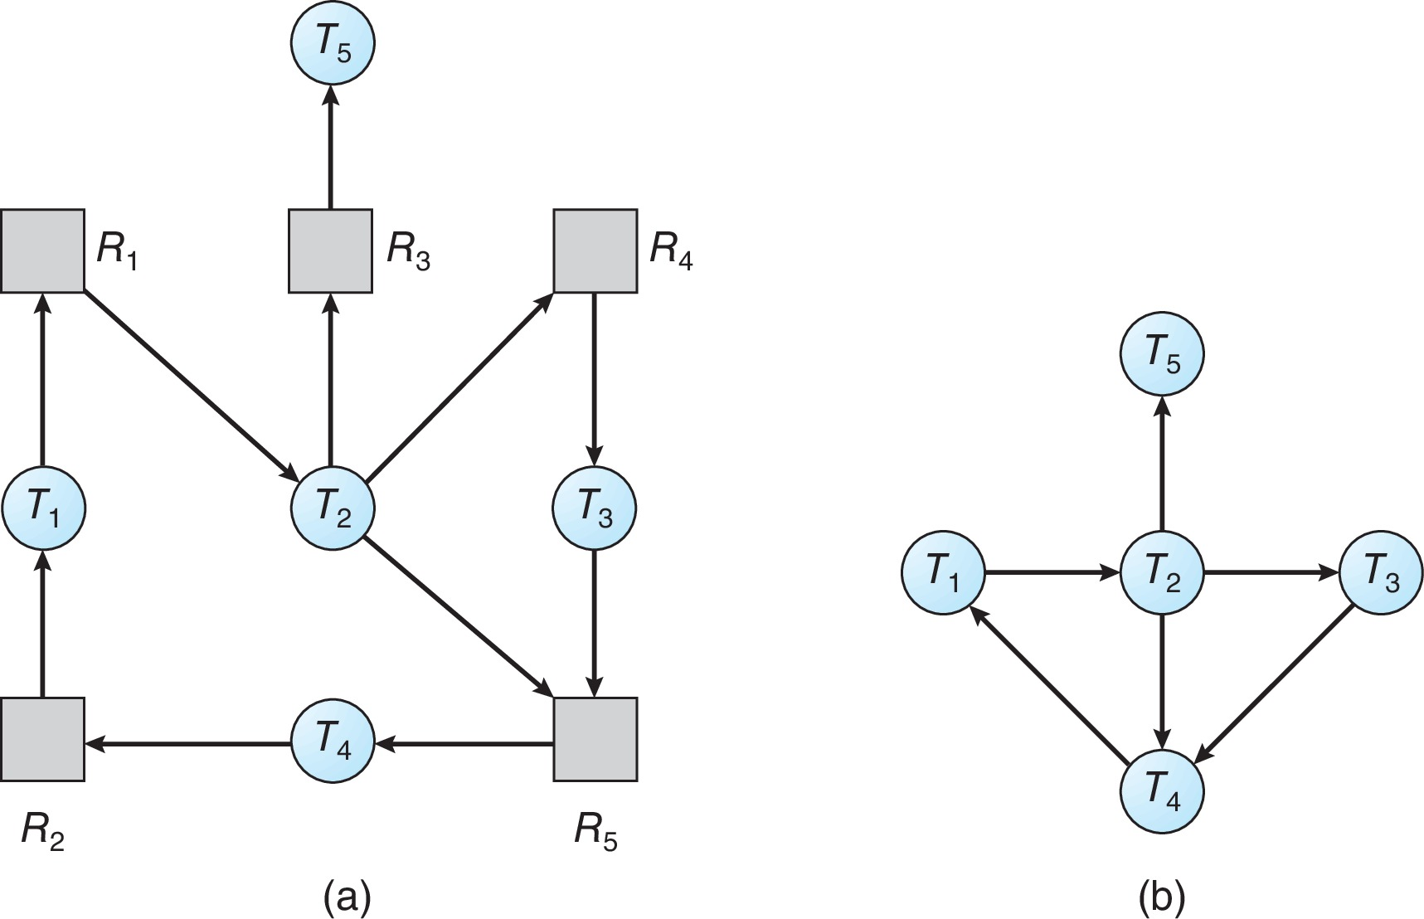
Resource-Allocation Graph and Wait-for Graph
Resource-Allocation Graph
Corresponding wait-for graph

Slide 52
Several Instances of a Resource Type
Available: A vector of length m indicates the number of available resources of each type
Allocation: An n x m matrix defines the number of resources of each type currently allocated to each process
Request: An n x m matrix indicates the current request of each process.
If Request [i][j] = k, then process P_{i} is requesting k more instances of resource type R_{j}.

Slide 53
Recovery from Deadlock: Process Termination
Abort all deadlocked processes
Abort one process at a time until the deadlock cycle is eliminated
In which order should we choose to abort?
Priority of the process
How long process has computed, and how much longer to completion
Resources the process has used
Resources process needs to complete
How many processes will need to be terminated
Is process interactive or batch?

Slide 54
Recovery from Deadlock: Resource Preemption
Selecting a victim – minimize cost
Rollback – return to some safe state, restart process for that state
Starvation – same process may always be picked as victim, include number of rollback in cost factor

Slide 55
End of Chapter 8

